Slide 1
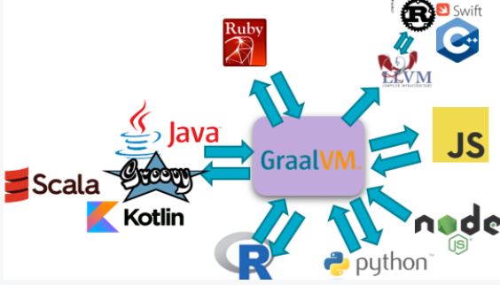





How and why GraalVM is quickly becoming relevant for you
DOAG 2020, November 2020
Lucas Jellema, CTO & Architect AMIS | Conclusion

Slide 2

Spaghetti recht

Slide 3
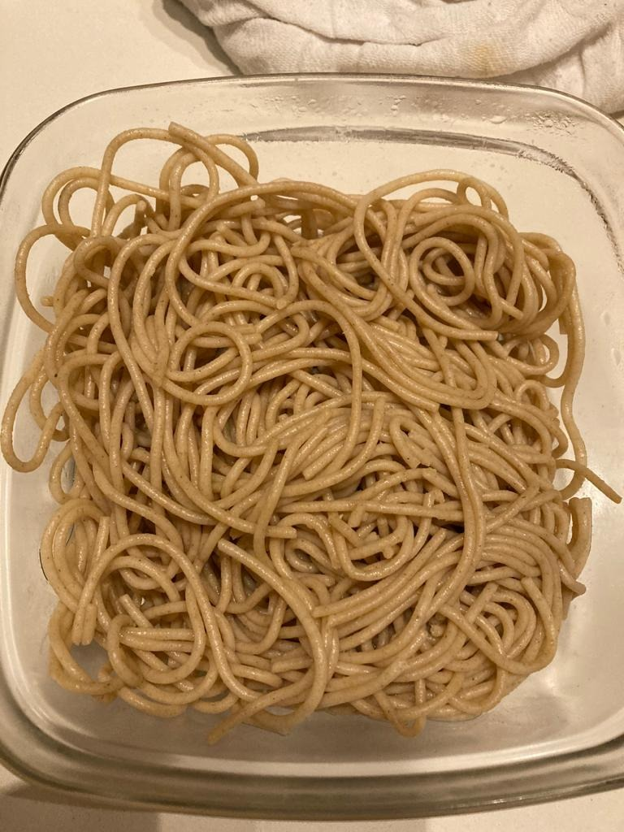

Spaghetti gekookt

Slide 4

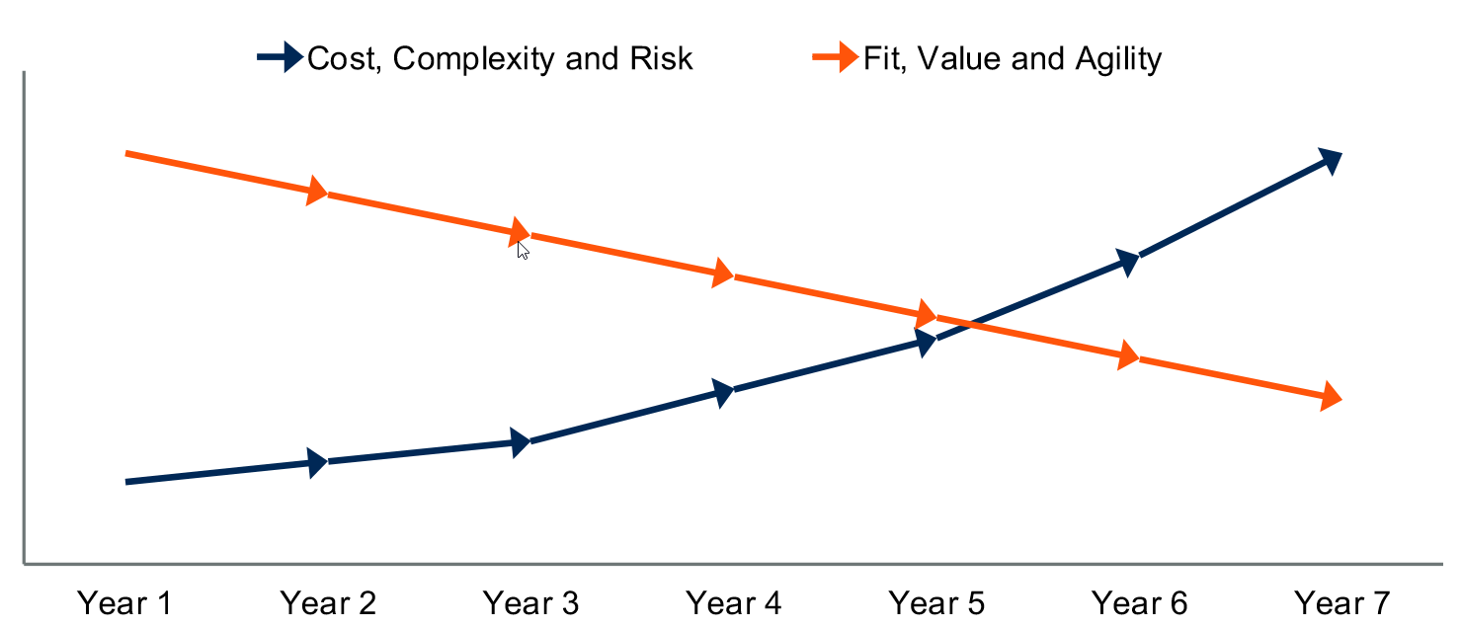
Lifetime of a software application

Slide 5
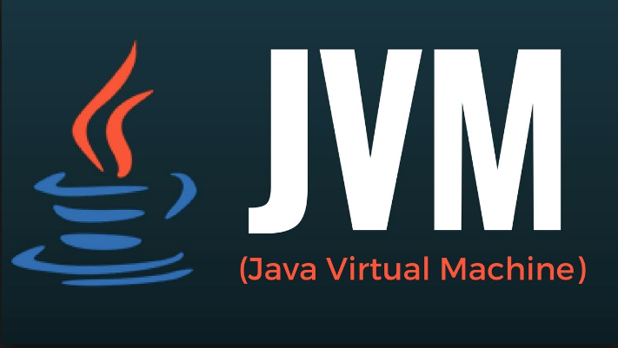
A wonderful piece of machine
Notes:
Java JIT CC
uit 1999?
Java applications run faster over time
because Hotspot VM JIT (C2 compiler) will compile hottest code paths to machine code to take over from interpreted code execution

Slide 6
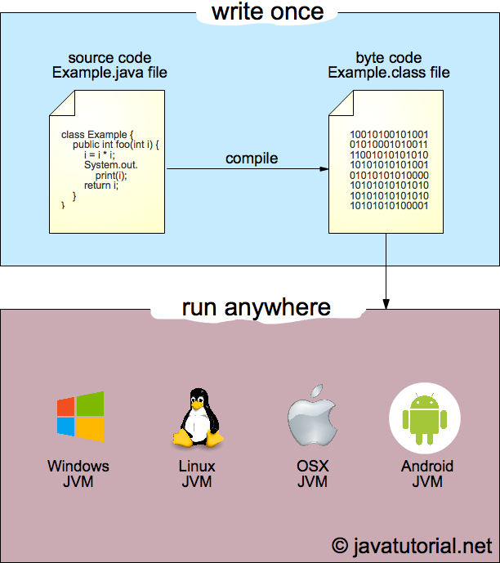

A wonderful piece of machine
Notes:
Java JIT CC
uit 1999?
Java applications run faster over time
because Hotspot VM JIT (C2 compiler) will compile hottest code paths to machine code to take over from interpreted code execution

Slide 7
Cost Complexity Risk
1999
2020

Slide 8
Fit, Value and Agility

Slide 9
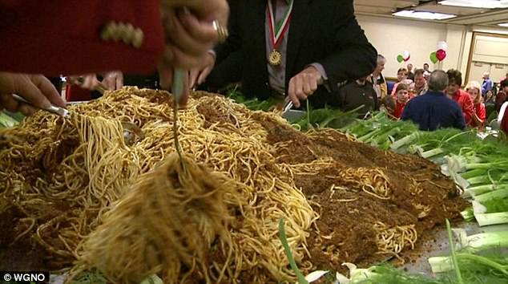
Big Bowl

Slide 10
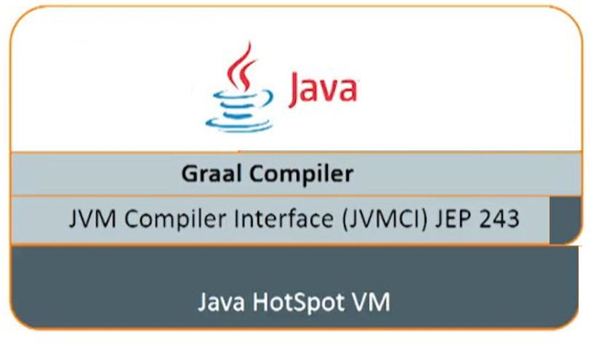
Notes:
new JIT compiler
for modern Java/JVM languages

Slide 11
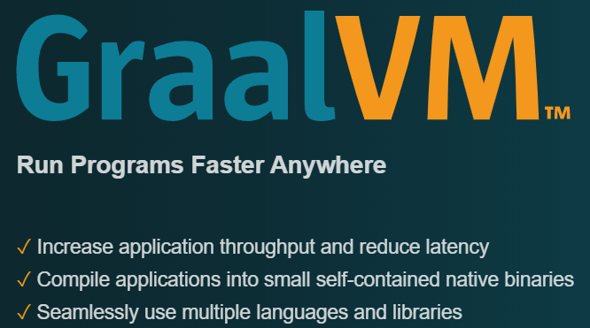

Slide 12
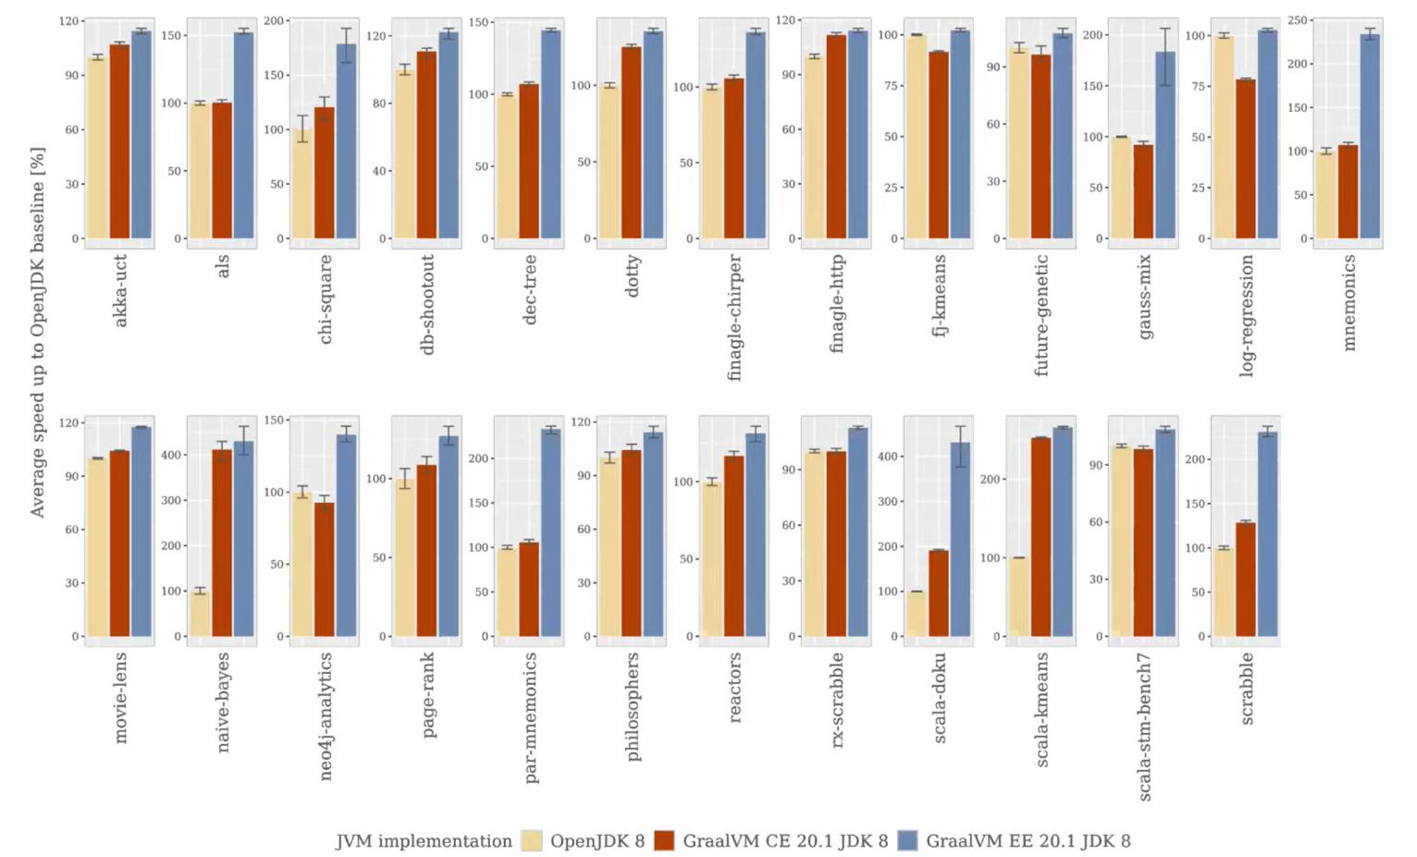
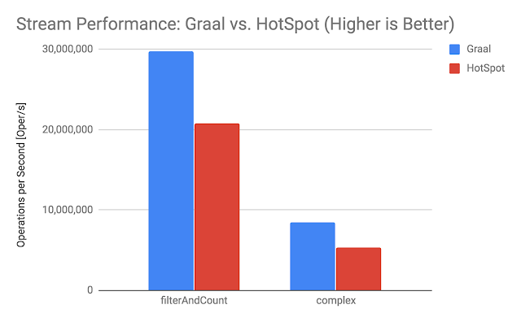
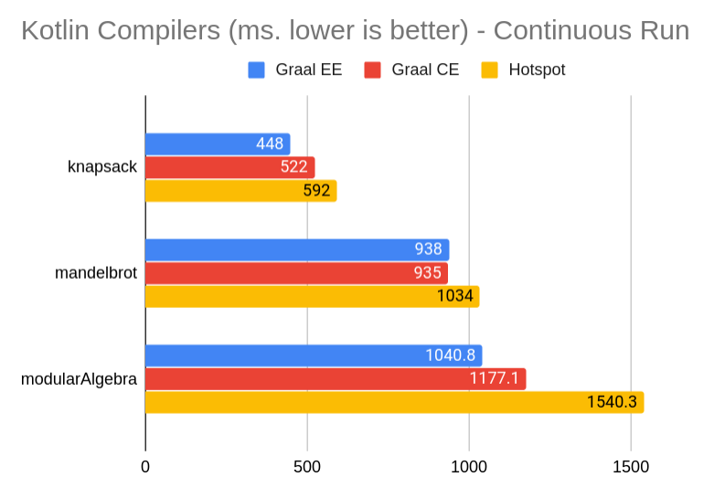
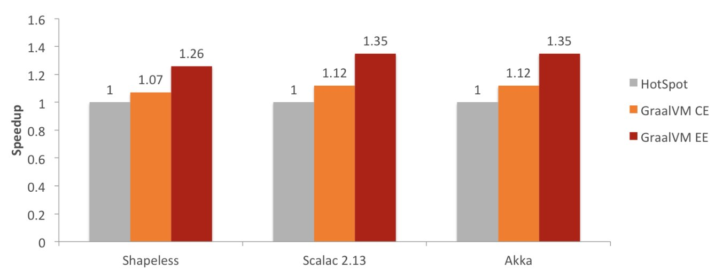


Slide 13
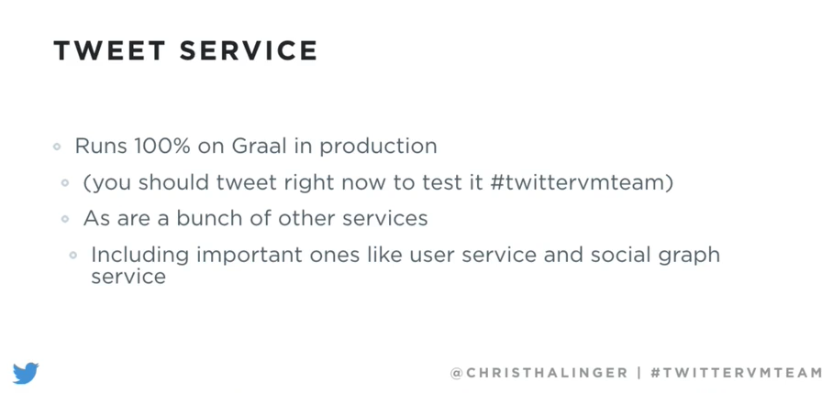


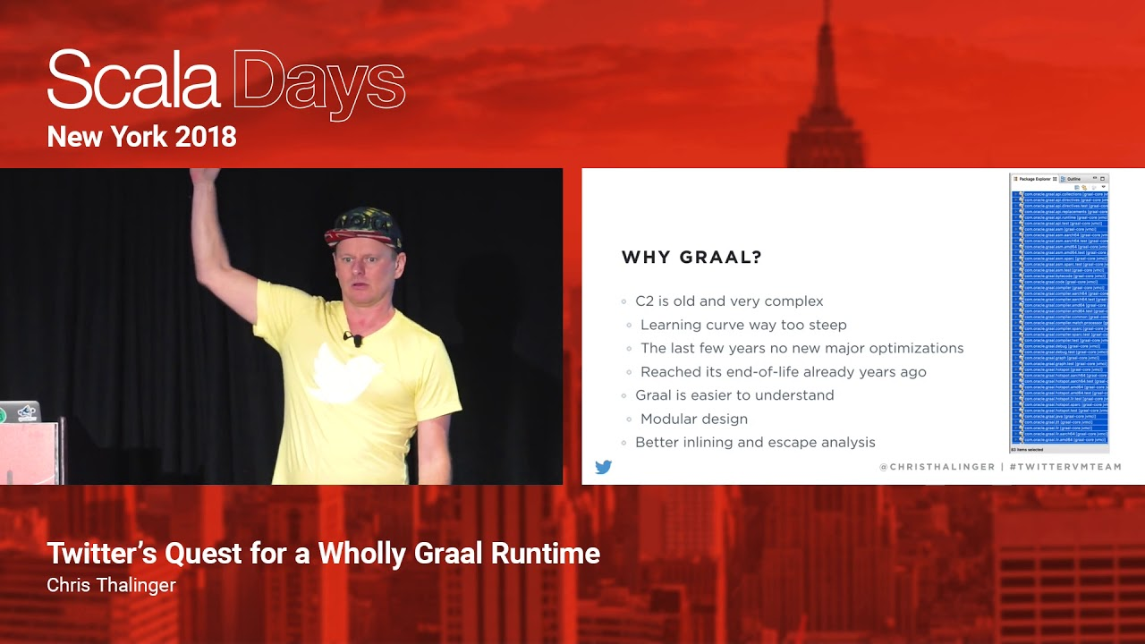
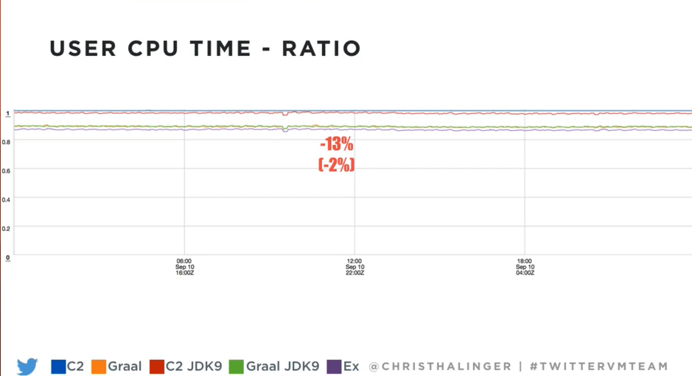

Slide 14


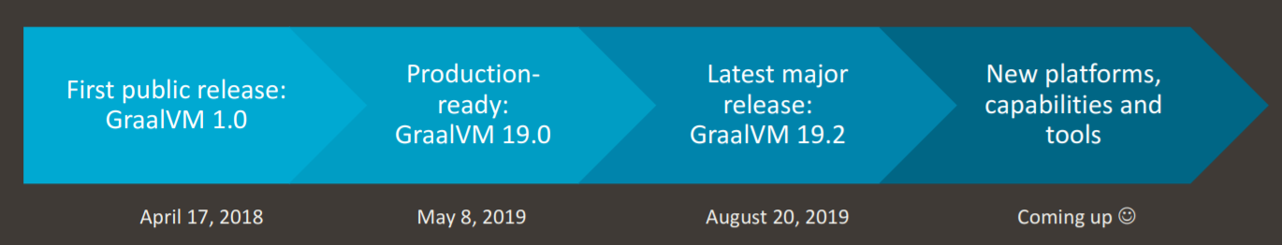

Some history on GraalVM
(limited) Spring Boot support for GraalVM native images
GraalVM support in Helidon, Micronaut & Quarkus
Project Fn GraalVM enabled
GraalVM “productized” at Oracle
Proof of Concept: a compiler written in Java (with all its software engineering advantages) could generate highly optimized code without compromising on compile times
Spring Framework 5.3 with GraalVM AOT support (October 2020)
Oracle Database MLE
Coherence support for GraalVM
WebLogic Certified on GraalVM
Project spun off from Maxine VM
20.2.0
2012
August, 2020
ES2020 support
Node 12.18 and iniitial ES2021 support
Twitter started to run its many Scala applications on the GraalVM JIT Compiler to save money and CPU cycles
Java 11 support
GraalVM Advisory Board
Ruby 2.6.6, Java 11.08, improved VS Code support
WebAssembly support
2017
2019
Notes:
https://openjdk.java.net/projects/graal/

Slide 15

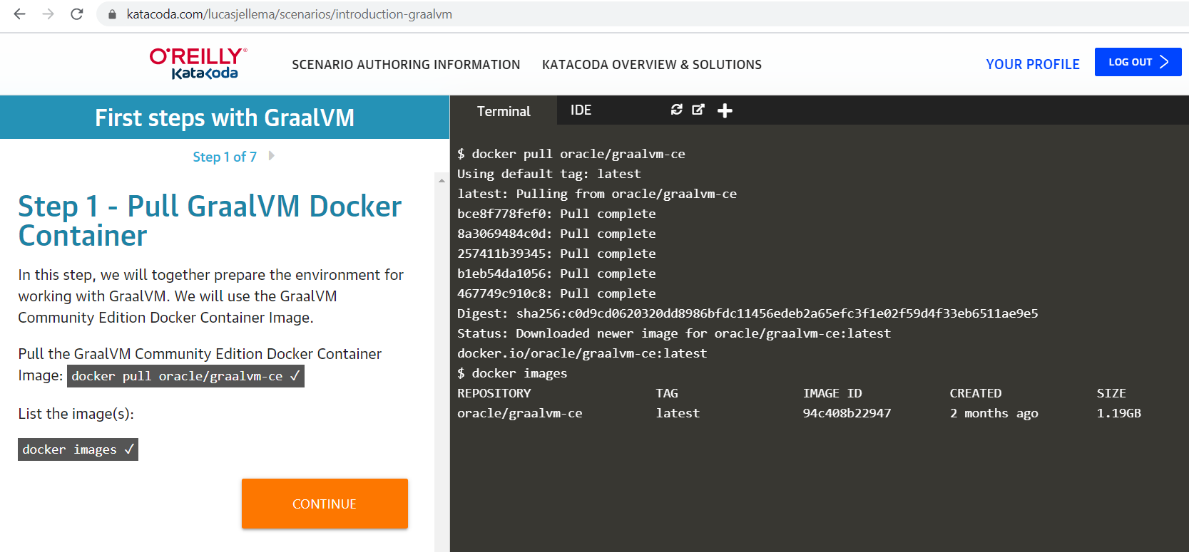
bit.ly/graalvm-handson

Slide 16


Slide 17
Native
Polyglot
Interoperability

Slide 18
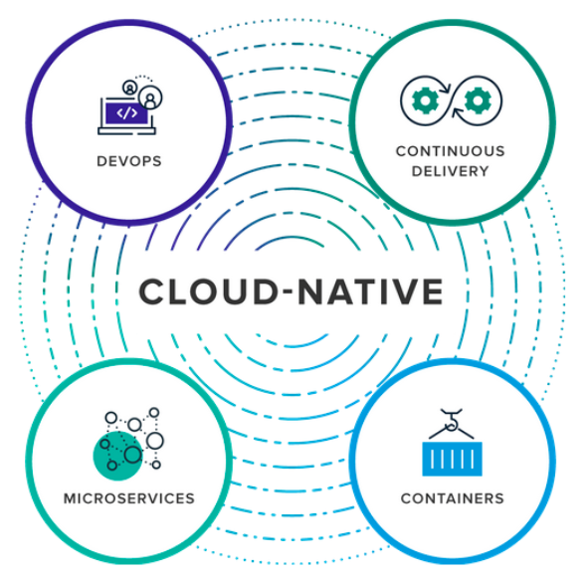




Slide 19
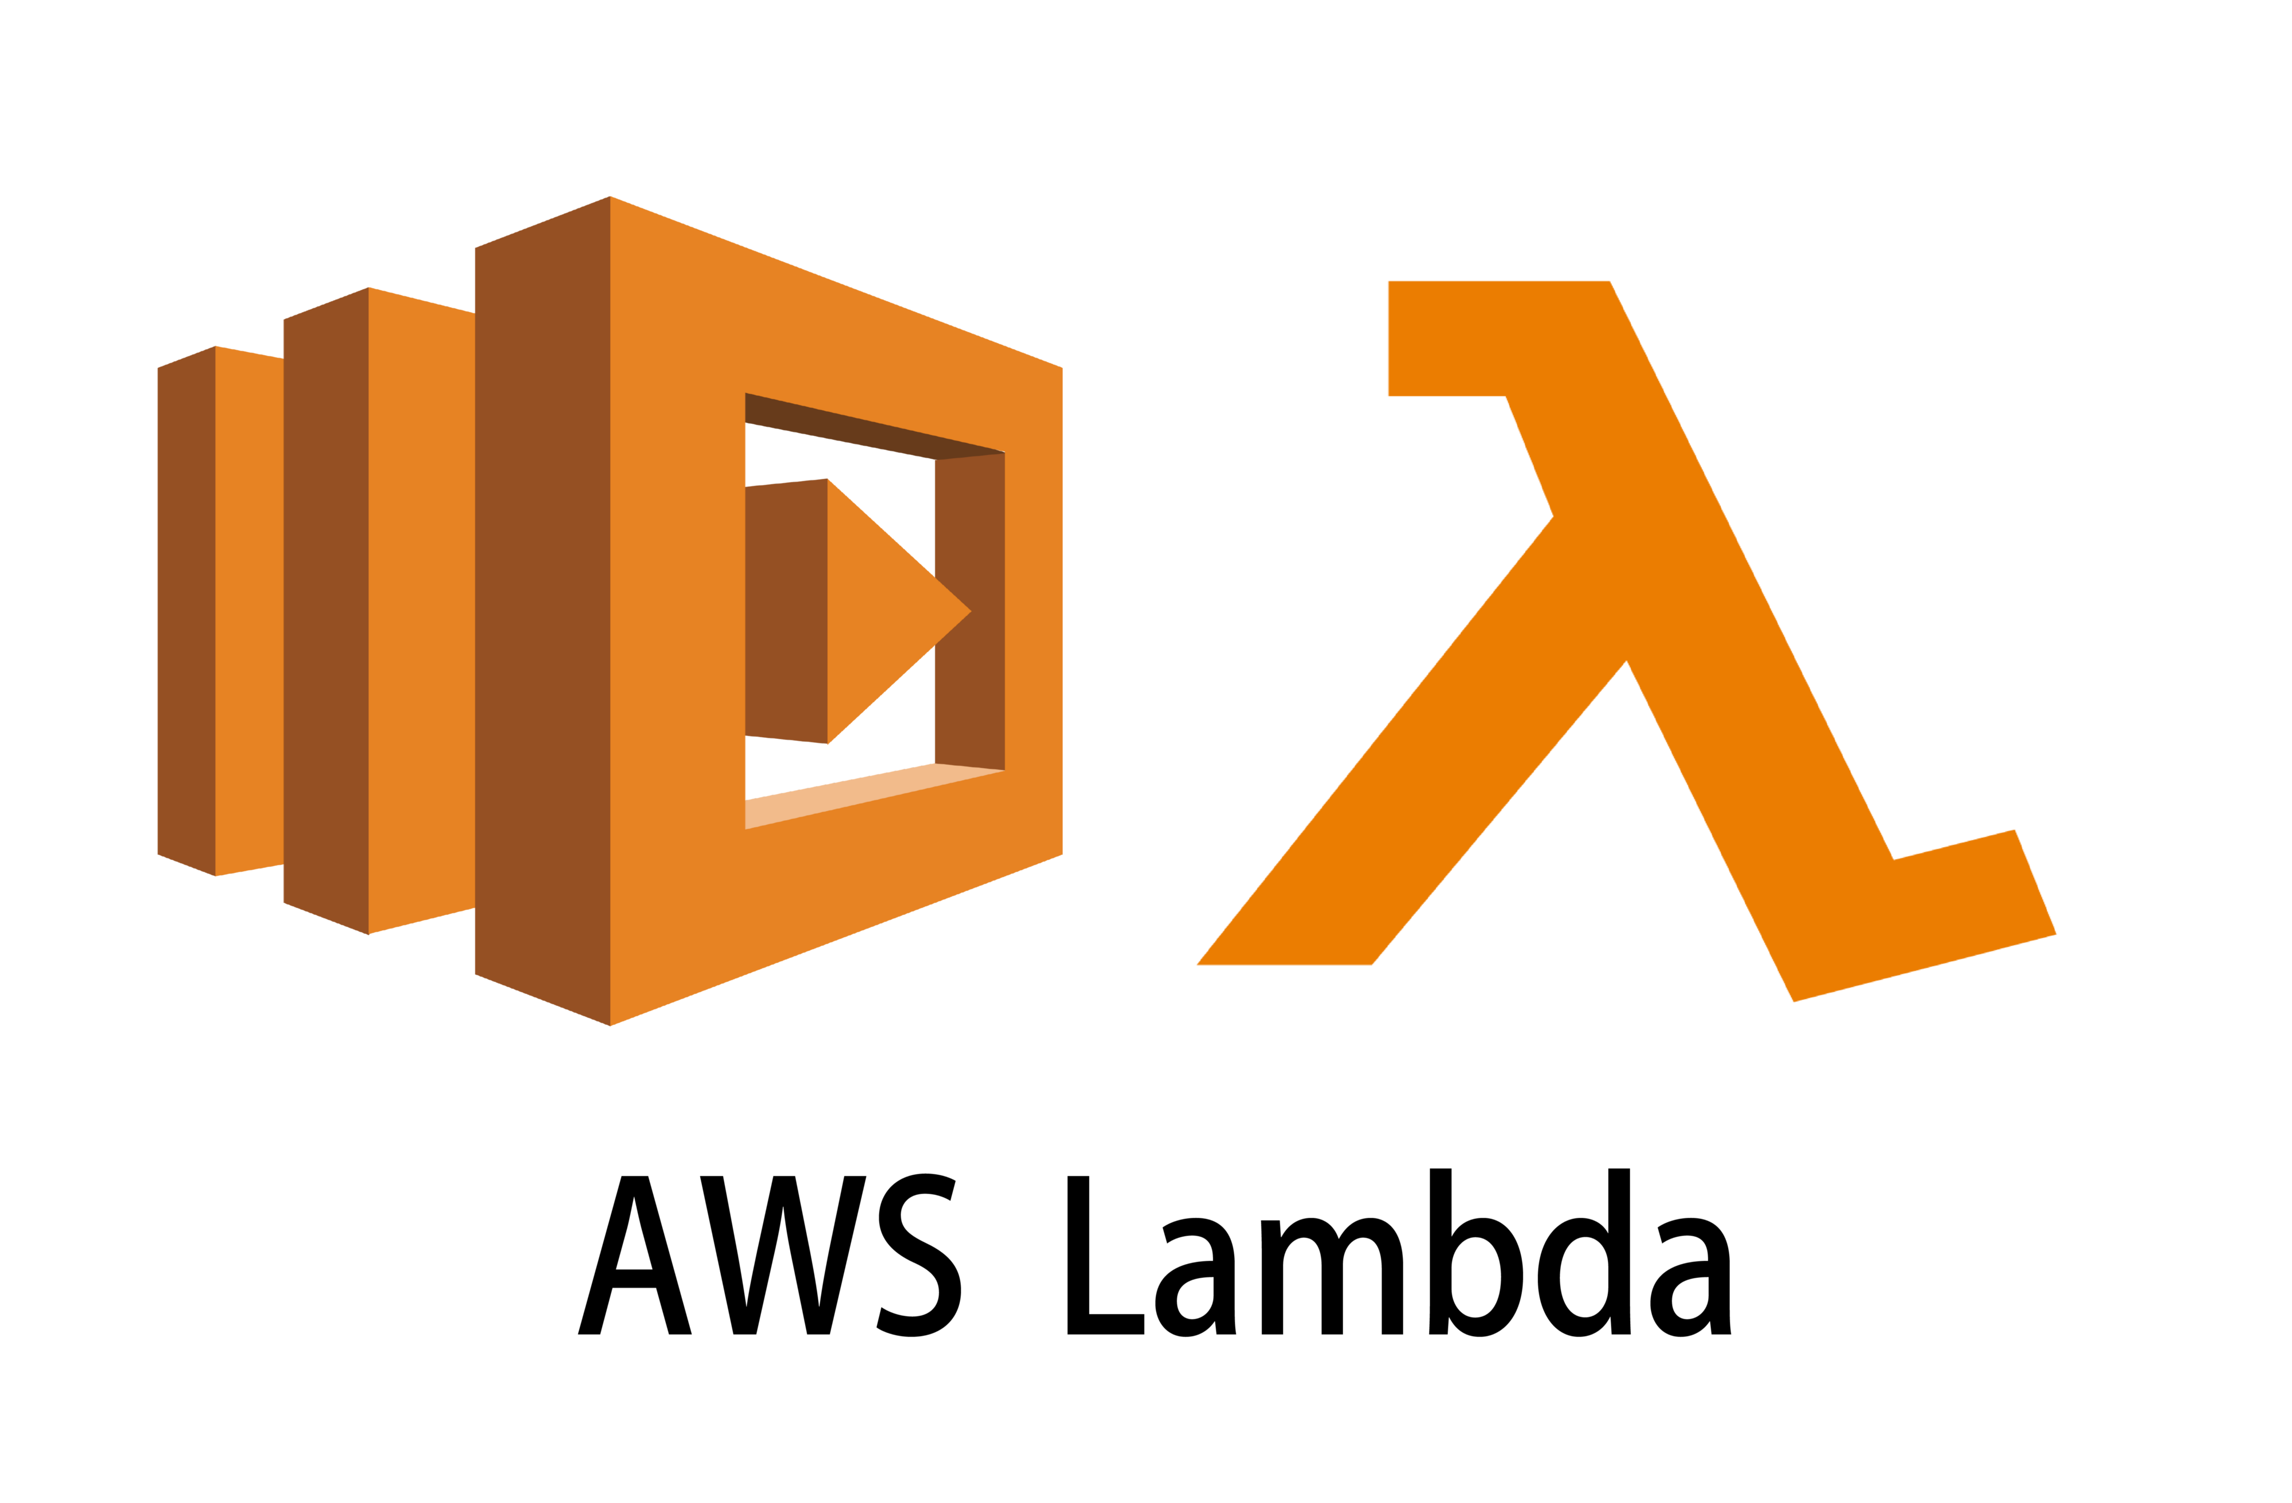







small application footprint
rapid
startup
simple runtime
fast execution
stateless, single request | event handling

Slide 20

small application footprint
rapid
startup
simple runtime
fast execution
stateless, single request | event handling

Slide 21
Native?!
a binary executable
that runs on just a bare O/S
possibly a minimal container or serverless function
fast startup
small footprint (disk & memory)
simple environment
fast execution
typically short-lived stateless request or event processing
not stateful and long running
not happily ever faster JIT compilation but build time AOT

Slide 22



Run Time
Code .java
Compile .class
Build .jar | .war
Just in Time compilation
Byte Code Interpretation
Tiered JIT compilation
Machine Code execution
Java Virtual Machine
Notes:
Two execution paths
program (java), compile (bytes/.class) , build (war/jar) (once) => run on JVM (JDK), JIT compilation (very often – in cloud native/serverless scenarios, not so much for long running, stateful Java Enterprise applications
program (java), compile (bytes/.class) => AOT into native (once per deploy) => run executable on OS (very often)

Slide 23
Run Time
Code .java
Compile .class
Build .jar | .war
Just in Time compilation
Byte Code Interpretation
Tiered JIT compilation
Machine Code execution
Code .java
Compile .class
Generate Native Binary Image
Java Virtual Machine
Ahead of Time compilation
Machine Code execution
Notes:
Two execution paths
program (java), compile (bytes/.class) , build (war/jar) (once) => run on JVM (JDK), JIT compilation (very often – in cloud native/serverless scenarios, not so much for long running, stateful Java Enterprise applications
program (java), compile (bytes/.class) => AOT into native (once per deploy) => run executable on OS (very often)

Slide 24
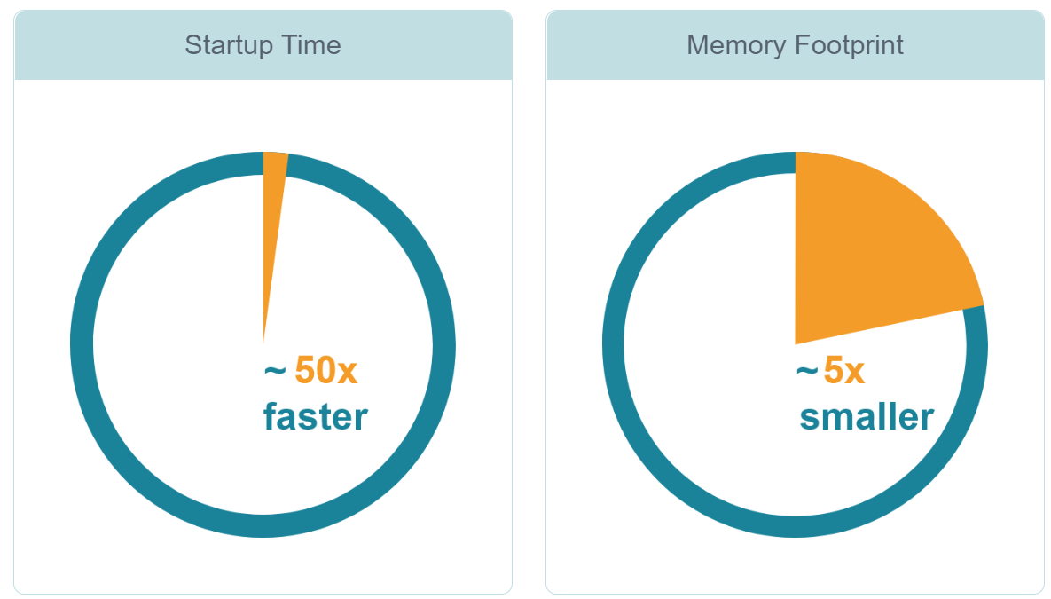
Native Images (AOT) versus JVM JIT

Slide 25
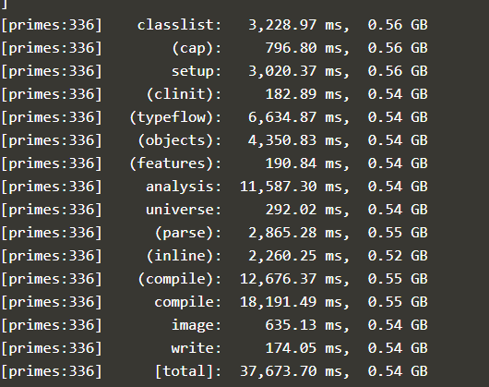
Ahead-of-Time Compilation
Input
Analysis
Output
Application
Points-to analysis
Run initializations
Heap snapshotting
Libraries
Machine Code
JDK
Image Heap
Substrate VM
All Java classes from your application, JDK and Substrate VM
Iterative analysis on all reachable methods, fields and classes
Native executable
Application running without dependency on JDK
Notes:
So let's see what is all happening in this Ahead of Time compiler in order to produce a native image.
At first step as input, GraalVM is taking everything that is consumed by the Java application, meaning the libraries, the JDK libraries, also resource like SubstrateVM, and what it does is a Closed World Analysis.
Closed World Analysis is an analysis of all reachable methods, fields and classes from the main class of the application. Because when you create this package binary, you don't want to include every JDK class there is, you don't want to include every library class there is. You want to package only what is used by your application, so Graal does a point-to analysis of what is reachable from the entry point of the application. Graal runs some of the static initializers and creates heap snapshots.
Then, we put everything together in a single binary. We put all the code AOT compiled code into the machine code section, and we write down a snapshot of the Java application as it was when initialized into the image heap section. This allows us to pre-initialize certain values or configuration parameters of the application, and we don't need to load them again when we start this binary.
This binary has a GC inside, so it still has some run-time system but it does no longer contain interpreter nor JIT compiler. AOT has a less advanced GC comparing it with JIT GC and no profiling data is collected for further improvement like in JIT
Startup time is probably the area where the Ahead of Time compilation is beating the JIT compilation by the largest margin

Slide 26

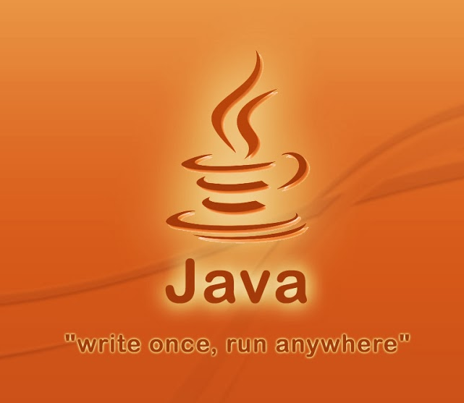


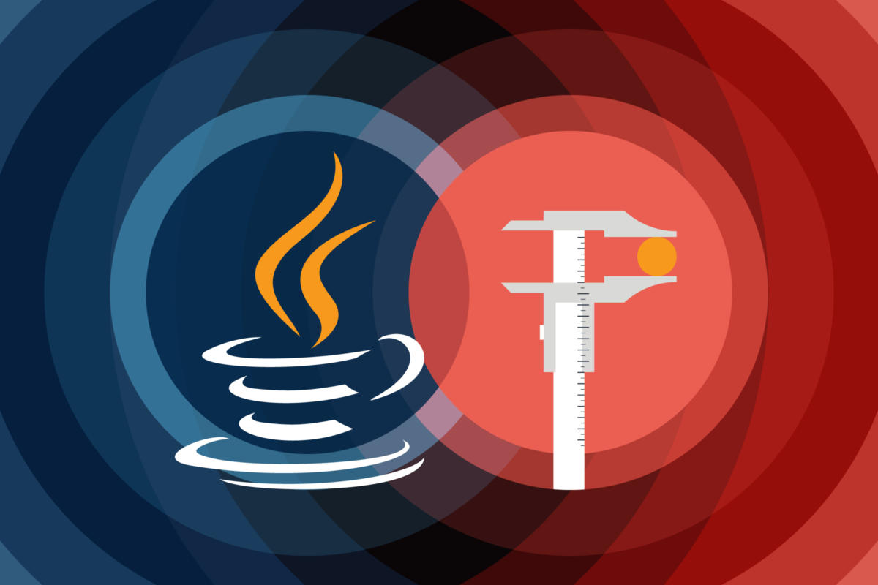


Notes:
mature
stable, reliable, hardened
runs anywhere
leverage modern hardware
envy of the world
of other programming languages

Slide 27
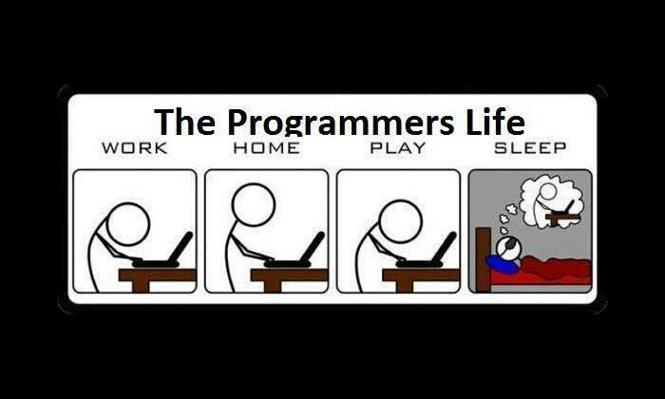

Slide 28

Program in X *)
Use my coding skills with X
Import existing code in X
Leverage libraries and native features of X
Run on an enterprise grade, fast and stable VM with tools to operate
*) X can be Node, Python, Ruby, R, … (and Scala, Groovy, Kotlin)
Notes:
dream in X
program X code or script
leverage skills
existing code
X’s libraries and USPs
run on enterprise grade runtime VM
similar to JVM languages such as Groovy, Scala, Kotlin, Clojure
and many more JVM-implementations of other languages

Slide 29
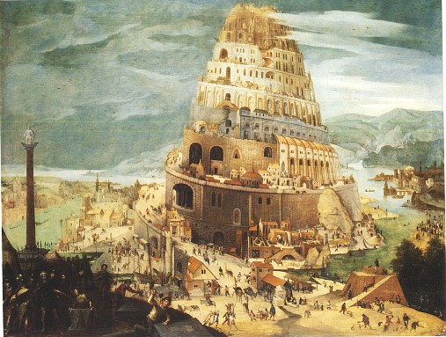
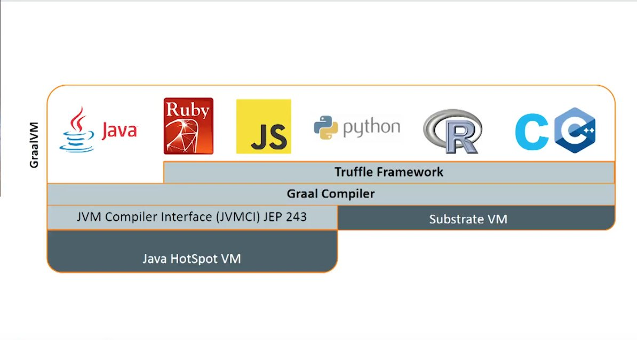

Slide 30
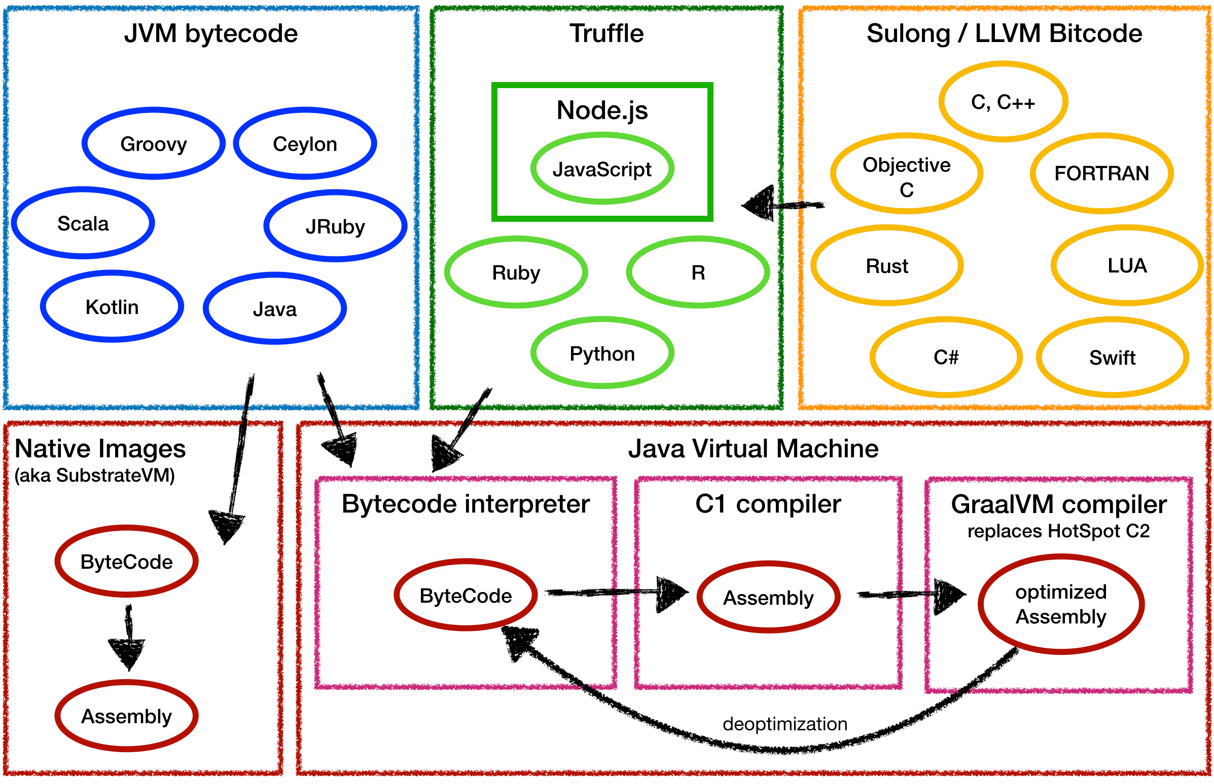


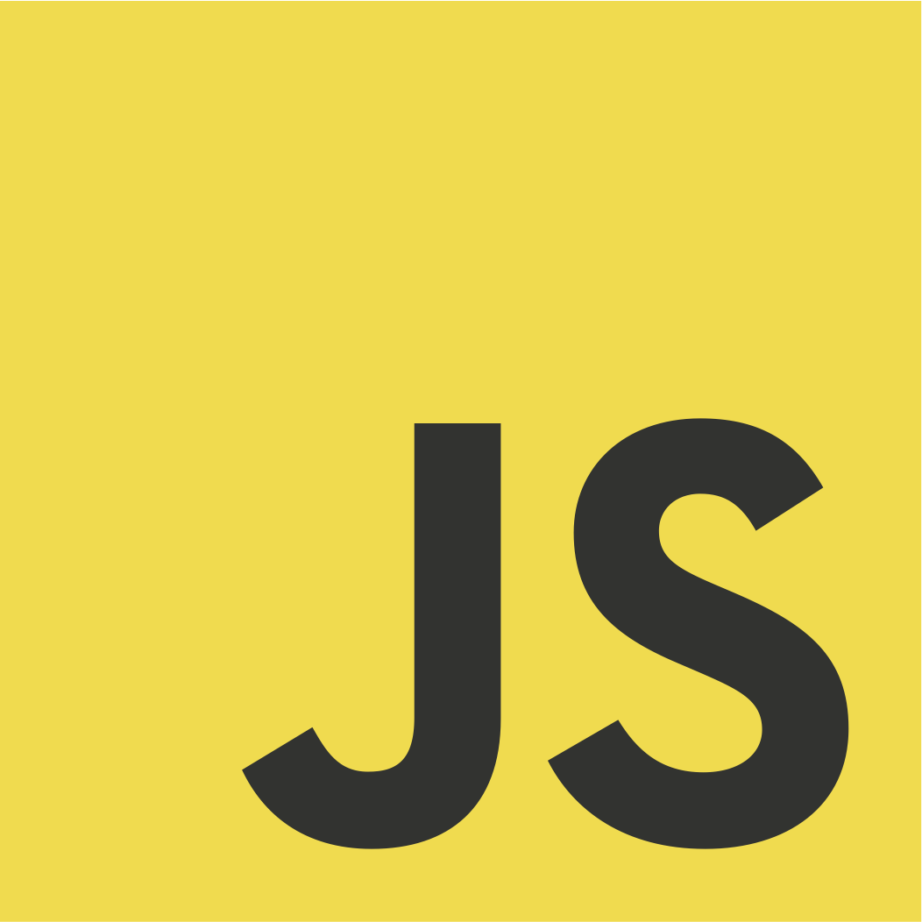
Oracle Database

Slide 31


Slide 32











Slide 33

The Grass is Greener
The other programming language …
is so much better at …
has great libraries for …
is the one used by our domain experts …
was used to implement modules we would like to reuse

Slide 34

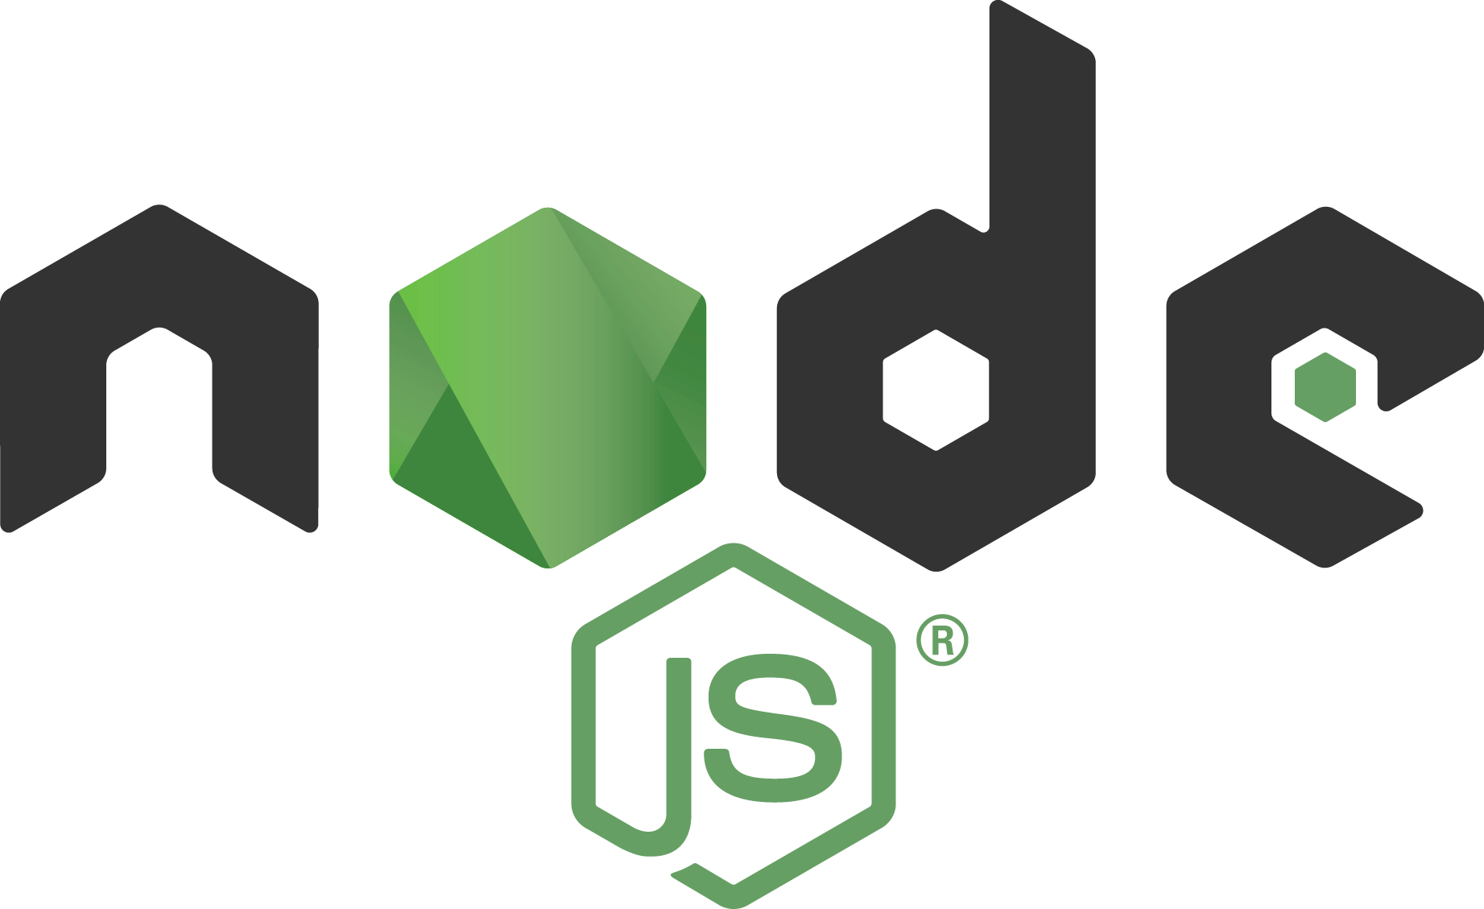
Extending the lawn by opening the fence
Notes:
GraalVM opens the fence – that grass becomes part of your lawn

Slide 35


Polyglot Interoperability
Establish frictionless interaction between language contexts
To benefit from the best of all wor(l)ds
Call out to ‘other world’ in a native way
Receive response in interpretable format
Minimal hoops to jump through at design time
Minimal performance overhead at run time
Uncomplicated run time environment
Despite multiple runtime execution languages
Basically: polyglot with the ease of mono-glot

Slide 36









Meta Language (concepts, grammar, structure)

Slide 37
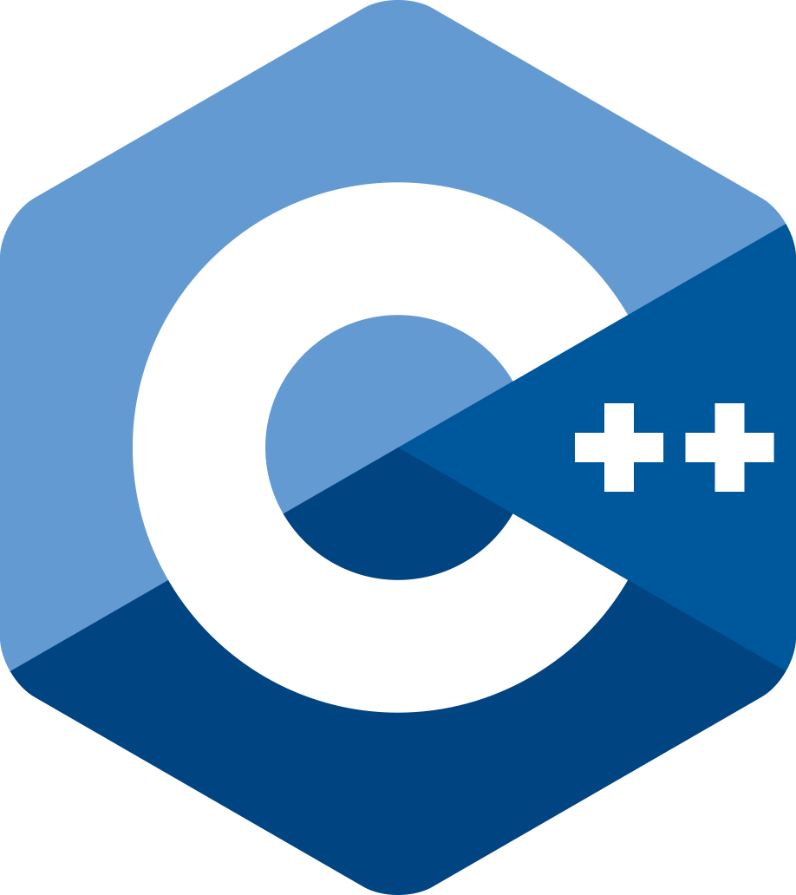




Abstract Syntax Tree (variables, loops, conditions, calls, arithmetic)
Truffle framework

Slide 38
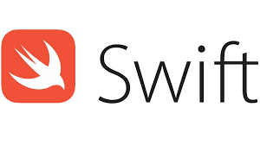
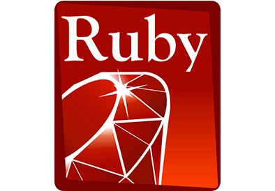

GraalVM can merge and run (Java Byte) code derived from various origins
Fortran
GraalVM provides generic objects in all supported languages to make Polyglot call-outs, evaluate embedded foreign code and share data across language contexts
This enables interoperability
Haskell
GraalVM Polyglot

Slide 39

CODE

Slide 40
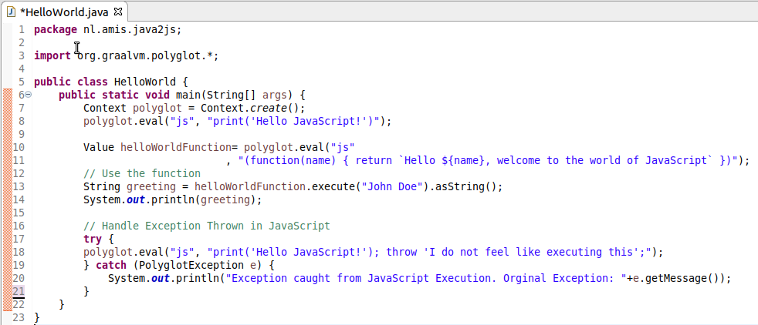
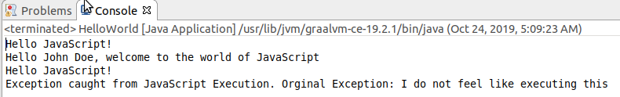
From Java to JavaScript Evaluate a Simple Code Snippet
Import Graal Polyglot package
Create Polyglot context
Evaluate Snippet
Notes:
https://www.npmjs.com/package/validator

Slide 41
From Java to JavaScript Evaluate a JavaScript Function – then call it as Java method
Import Graal Polyglot package
Create Polyglot context
Evaluate Snippet
Evaluate Snippet => instantiate function
Execute function
Notes:
https://www.npmjs.com/package/validator

Slide 42
From Java to JavaScript Handle exception in Java thrown in JavaScript
Import Graal Polyglot package
Create Polyglot context
Evaluate Snippet
Evaluate Snippet => instantiate function
Execute function
Handle Exception from JS
Notes:
https://www.npmjs.com/package/validator

Slide 43

A Typical Java Challenge (aided by JavaScript interaction)
Developing a Java application
Need to perform validations on input data
Postal Code (various countries), Mobile Phone Numbers (many countries), Email Address, Credit Card Number etc.
NPM Module Validator offers most of these OOTB
But… it is written in JavaScript
How does that help me?
Notes:
https://www.npmjs.com/package/validator

Slide 44
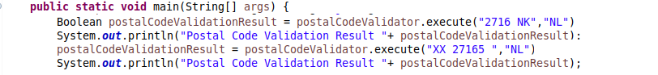
A Typical Java Challenge
Developing a Java application
I need to perform validations on input data
Postal Code (various countries), Mobile Phone Numbers (many countries), Email Address, Credit Card Number etc.
In Pseudo Code:
Notes:
https://www.npmjs.com/package/validator

Slide 45
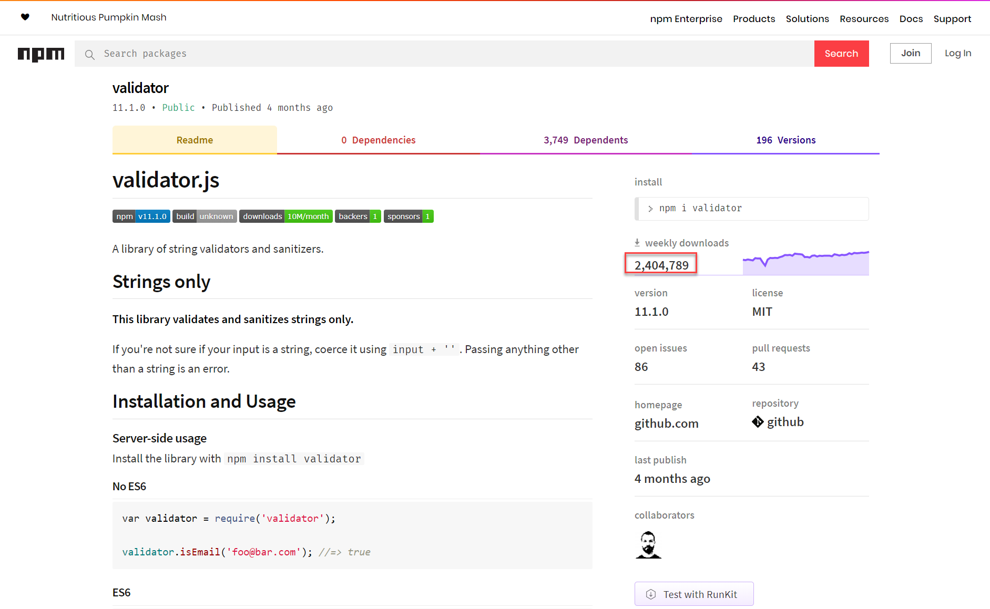
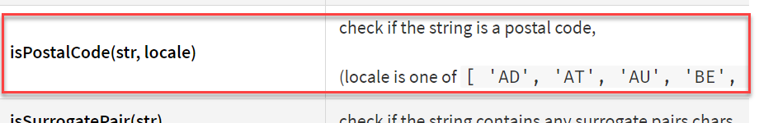
Validator.js – a community package with dozens of predefined validations … in JavaScript
Notes:
https://www.npmjs.com/package/validator
https://www.graalvm.org/docs/reference-manual/compatibility/#validator

Slide 46
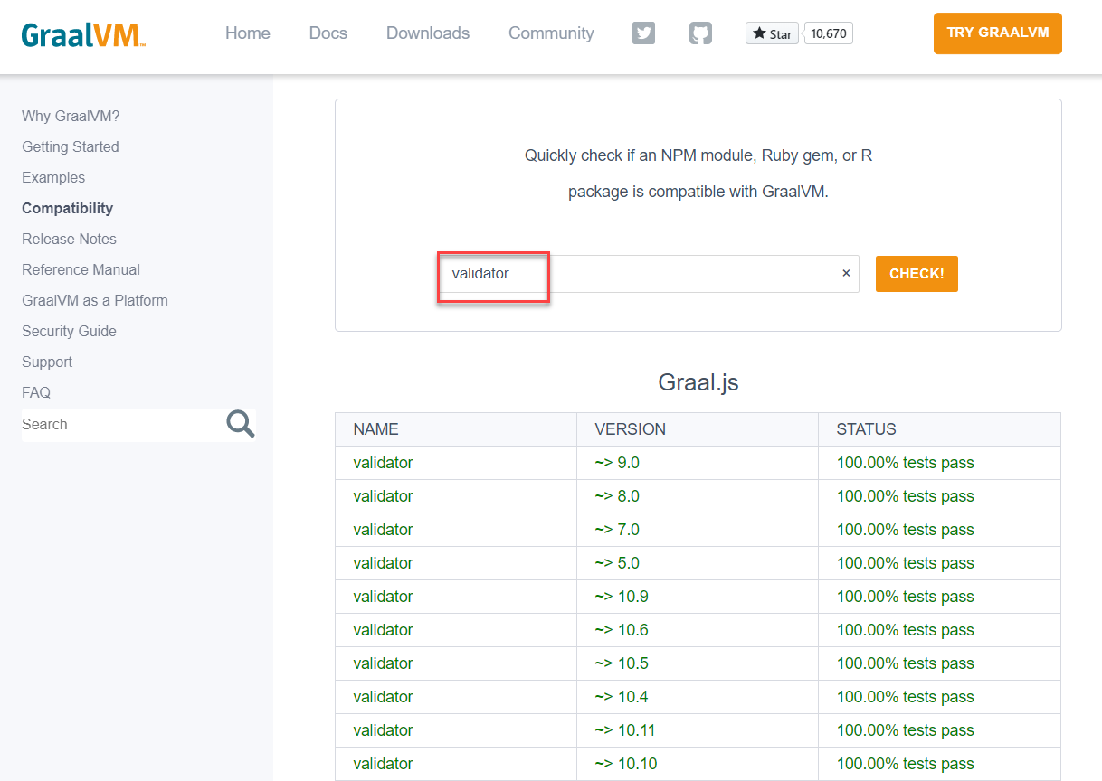
JavaScript Validator Module is compatible with GraalJS
Notes:
https://www.npmjs.com/package/validator
https://www.graalvm.org/docs/reference-manual/compatibility/#validator

Slide 47

A Typical Java Challenge – Resolved (with GraalVM)
Embrace GraalVM as the Java runtime
Install npm module validator
Install and use webpack to create a single bundle for module validator
Extend Java application
Import GraalVM Polyglot package
Create JavaScript Context
Load validator_bundled.js into context
Get desired JS functions from bindings map
Execute required JS functions
as if they were Java methods
Notes:
https://www.npmjs.com/package/validator
https://www.graalvm.org/docs/reference-manual/compatibility/#validator

Slide 48
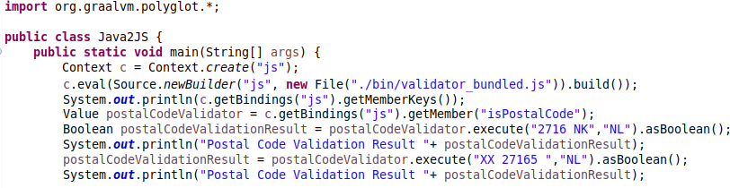
A Typical Java Challenge – Resolved (with GraalVM)
Notes:
https://www.npmjs.com/package/validator

Slide 49
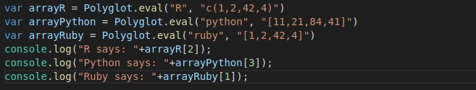
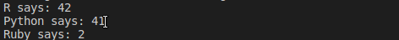
Polyglot from JavaScript to other Graal Truffle Languages
Polyglot.eval can execute any language snippet
It returns data objects (to read/write) or functions (that can be executed)
GraalVM Polyglot

Slide 50



Polyglot from non-JVM languages Dutch National Police Case: Scala ⬄ (Fast)R on GraalVM
GraalVM Polyglot

Slide 51

Conclusion

Slide 52
Custom DSL
Interoperable
Polyglot
JIT
Tools
Native
source: https://www.beyondjava.net/what-about-graalvm
Notes:
https://www.beyondjava.net/what-about-graalvm

Slide 53
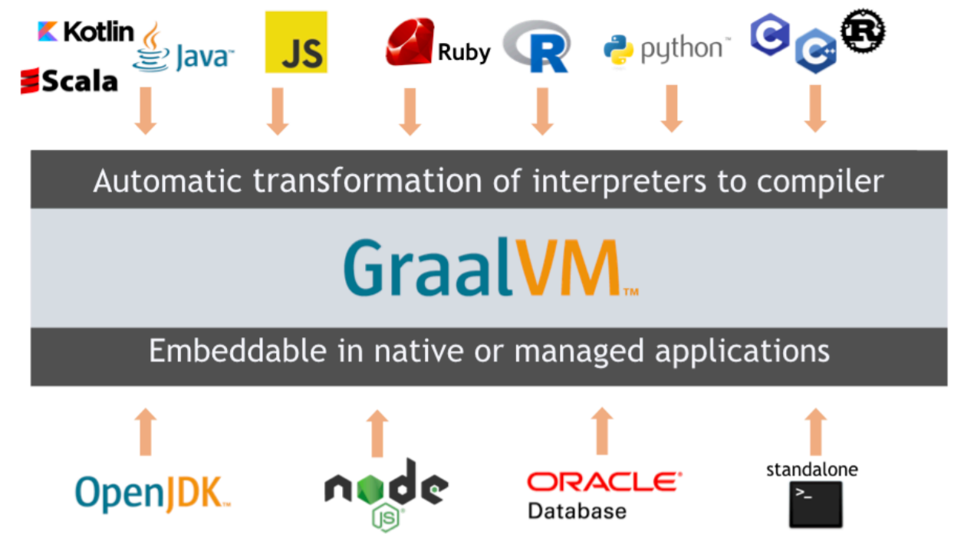
Quick Recap – What is GraalVM?
Thomas Wuerthinger: “a new virtual machine that is trying to execute many languages faster”
JIT Foundation for the Long-Term Evolution of HotSpot JVM
Stable, observable, manageable and maintainable JVM with optimizations for modern Java and JVM language patterns
Serverless Java through native image generation
Small footprint, rapid startup time, simple & small run time
Polyglot VM and Cross Language Interoperability platform
Run and interact between many languages
Bonus features
Custom DSL
Native interaction between C/C++ and Java
Polyglot Tools: Debugger (with Chrome Dev Tools), Profiler, GraalVM VisualVM, Ideal Graph Visualizer, Visual Studio Code extension for GraalVM
Notes:
https://www.graalvm.org/docs/reference-manual/tools

Slide 54
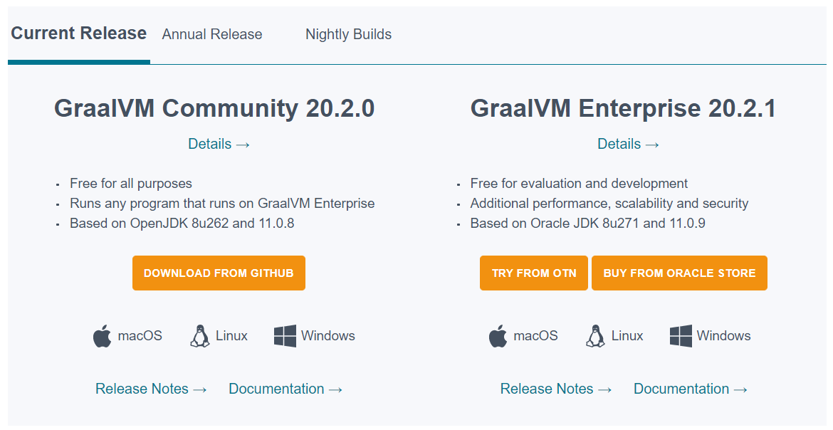
GraalVM: Two Editions
Notes:
Spaghetti…
Hotspot C2 compiler for runtime optimizations had gotten very complicated and very hard to maintain. It does not support optimization for modern code patterns. The C++ code had gotten out of hand

Slide 55
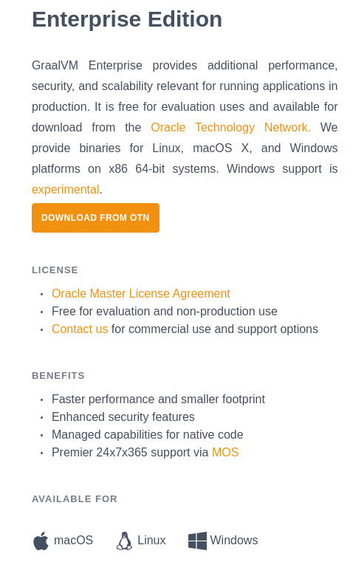

GraalVM EE included in all OCI subscriptions
GraalVM Enterprise is included in all Oracle Cloud Infrastructure (OCI) subscriptions so you can use it for no additional charge (Compute, OKE, Functions, ...)
Notes:
https://blogs.oracle.com/graalvm/accelerating-oci-applications-with-graalvm-enterprise
For OCI user workloads, GraalVM Enterprise can be used in the following deployment scenarios:
Bare Metal and Virtual Machines (OCI Compute)
Containers (Oracle Container Engine for Kubernetes)
Functions (Oracle Functions)

Slide 56
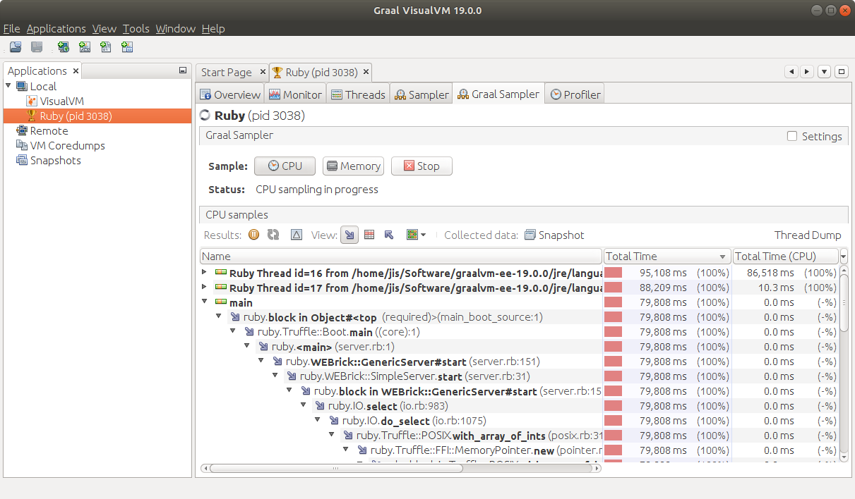
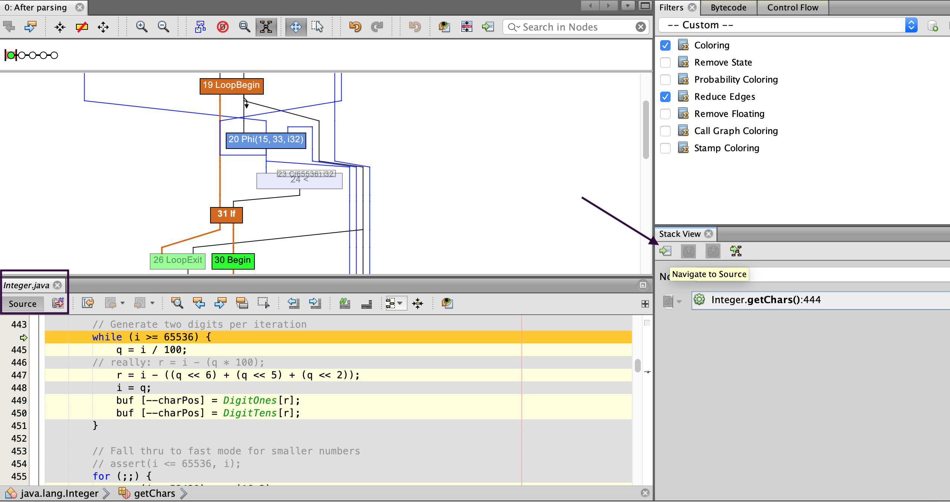
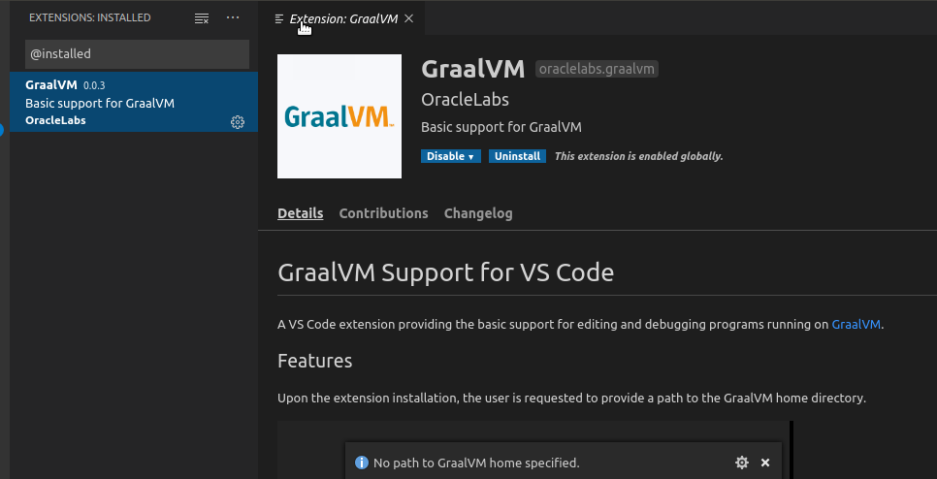
Tools in the GraalVM Ecosystem
Debugger linked to Chrome DevTools
Profiler – command line CPU Sampler, CPU tracer and Memory tracer
Graal VisualVM – Visual CPU Sampler, Heap Analyzer
Visualizing Java Flight Recorder data
Ideal Graph Visualizer
view and inspect interim graph representations from GraalVM and Truffle compilations
Visual Studio Code Extensions
Editing and debugging applications running on GraalVM
Notes:
https://visualvm.github.io/graal.html
https://github.com/oracle/graal/tree/master/vscode/graalvm
https://www.graalvm.org/docs/reference-manual/tools/#visual-studio-code-extensions-for-graalvm
https://www.graalvm.org/docs/reference-manual/tools/

Slide 57

Adopting GraalVM in your team - your first steps
Start exploring GraalVM – download & install, play and do a PoC
Plenty of resources available (code samples, blog articles, tutorials, ..)
Hybrid: have some containers running GraalVM (for Java applications) instead of your traditional JVM brand
to try out, check if it is stable and performant and (better) manageable
AOT/native - use GraalVM to build Java applications as native executables as last step in the build process and deliver that executable instead of JAR files
create Java based Serverless Functions with small footprint and very quick startup
benefit from ultra fast and super small frameworks (Quarkus, Helidon, Micronaut, , Vert.x, Spring, …)

Slide 58
Adopting GraalVM in your team - your next steps
Start leveraging polyglot
single runtime for different programming languages)
interoperability (benefit in Java from 3rd party libraries in JavaScript or Python [or vice versa] and/or make better use of the skills in your team)
better start creating standards and guidelines around when and how to polyglot!
Fortran
Haskell
GraalVM Polyglot

Slide 59



Thank you for your attention
Slides:
https://bit.ly/...
Katacoda Live Handson Environments
bit.ly/graalvm-handson
lucas.jellema@amis.nl | technology.amis.nl | @lucasjellema | lucas-jellema

